Slide 1
Integrating Sanitation and Handwashing
into PEPFAR Programming

Slide 2
WHY WASH Matters for PLHIV
Diarrhea affects 90% of people living with HIV and AIDS, significant morbidity and mortality
Diarrheal disease reduces antiretroviral absorption
Diarrhea reduces absorption of nutrients
Burden on caregivers in clinics and at home
Cause of humiliation and lower quality of life
People with HIV/AIDS have greater water needs
Notes:
As we know, most diarrhea is caused by unsafe water, inadequate sanitation and poor hygiene….
in people with immune compromised systems, diarrhea can happen more often and more severely
Most people living with HIV get diarrhea….
And diarrhea reduces a body’s ability to absorb life saving medicines and nutrients in food….this causes malnutrition which further exacerbates the effects of HIV
Further….care givers have increased work in taking care of someone with diarrhea and the feces in the environment puts others in the home at risk of getting diarrhea as well
Finally, people with HIV have greater water needs….to take medicines and for cleaning and washing
As transition..
WASH, water, san and hygiene can mean many things to many people..
For this webinar, when referring to WASH, we’re focusing on 3 specific practices… safe drinking water, hand washing and snia.
Which have all been shown to make a difference in both general and immuno compromised populations

Slide 3
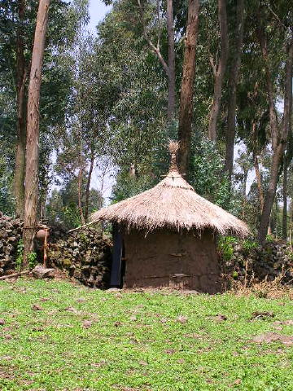
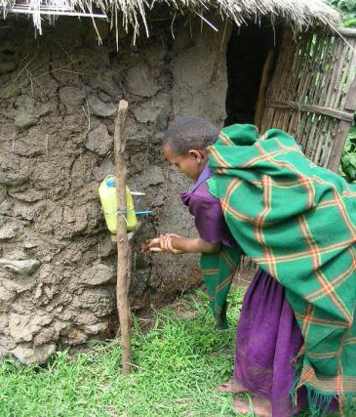
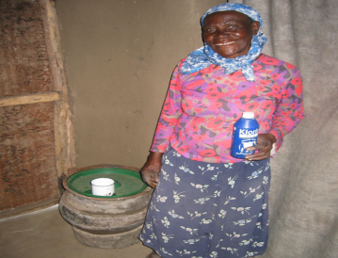
WHAT?
Critical WASH Behaviors
…make a difference for PLHIV and their families
30% ++
Safe Feces Disposal
Treatment & Safe Storage of Water
21%
30-50%
Handwashing
43%
Notes:
What is Scale?
5/3/2012
Overview Complete Process
3
The numbers on the screen indicate the decrease in diarrheal disease among the general population when practicing the different critical WASH behaviors: Treatment and Safe Storage of Drinking Water; Handwashing and Sanitation.
Regarding people living with HIV and their families, the most powerful study was conducted by Lule from the US Centers for Disease Control, et al in Uganda in 2005. Using the safe water system that treats water and stores it in a closed container with a tap reduced diarrhea risk by 25% and number of days ill by 33%
Presence of latrine was associated with reduced diarrhea risk by 31% and number of days ill by 37%
Presence of soap was associated with reduced number of days ill by 42%
Similar results in Kenya and Nigeria.

Slide 4
Stigma can further reduce access
Families affected by HIV have need for greater quantity and better quality of water for drinking, washing, handwashing and livelihood
More challenging sanitation demands
Stigma and fear can further reduce essential access to water and restrict use of latrines.
Notes:
While quite difficult to document, stigma and fear can further reduce essential access to water and restrict use of latrines.
People even suspected of having HIV have been barred from using community water points and shared latrines …

Slide 5
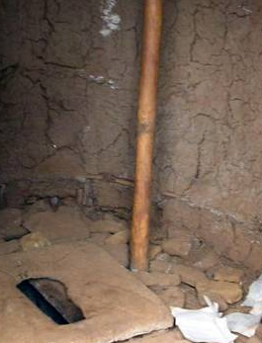
HOW
Integrate Sanitation into PEPFAR Programming improving intervention quality and content
  Review and strengthen guidance on Sanitation within HIV technical guidance and guidelines and programs
  Strengthen capacity of TWGs and partners
  Conduct advocacy to include a broader spectrum of WASH programming interventions in Country Operating Plans
    beyond water treatment
    Focus on sanitation, handwashing, menstrual management
  Use existing guidance and resource documents, including the COP Toolkit

Slide 6
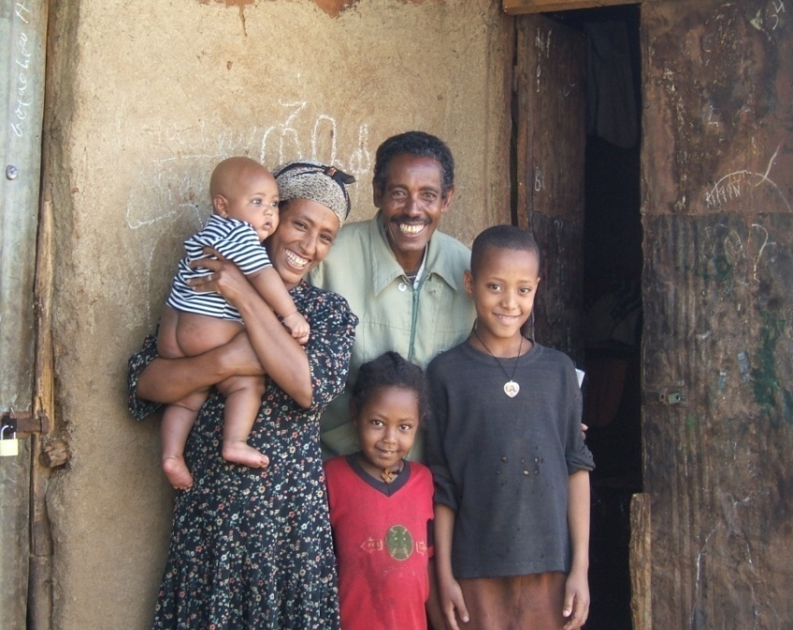
HOW (Continued)
Country-level Integration Points
Home-based Care
Orphans and Vulnerable Children
Counseling and Testing
Prevention of Maternal to Child Transmission
Nutrition and HIV
HIV considerations
  for water & sanitation sectors
      Greater water needs
      Inclusive sanitation designs
      Inclusive water pump designs
Notes:
Water, sanitation and hygiene should be integrated into different types of HIV programs. To date, most emphasis has been in Home-based Care programs, but there are valid considerations for integrating sanitation and handwashing into other HIV programming as well..
Another important area for integration is including HIV considerations into water and sanitation programs. This means assuring easier access to much needed water sources and simplifying the process for gathering water, for example, by creating longer pump handles that are easier to use, or by building larger latrines so a caregiver can help a weak but still mobile person use the latrine.

Slide 7
HOW (continued)
Country WASH - HIV Integration Actions
Review Basic Care Package in your country and include sanitation and handwashing materials
Incorporate sanitation and handwashing questions into assessments and field visits
Build sanitation and handwashing activities into new and existing programs
Collect and circulate PEPFAR success stories that support sanitation activities
Ensure national HIV policy documents highlight sanitation and handwashing

Slide 8
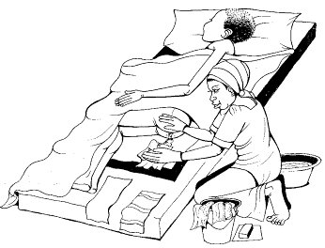
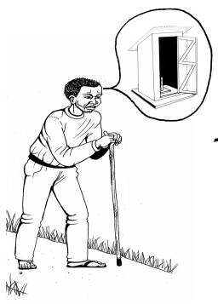
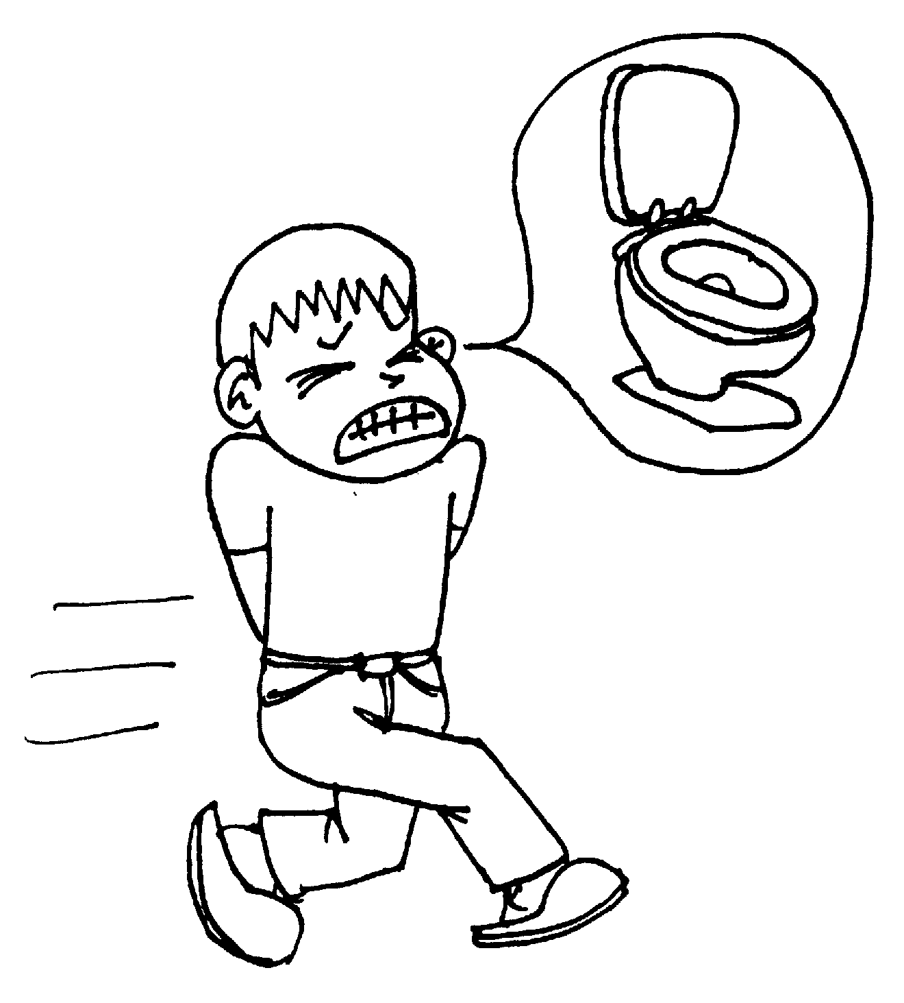
Sanitation
Safe disposal of feces
Bed Bound Client
Weak Client
Mobile Client
Notes:
Sanitation is often forgotten. People with HIV are in different stages: some are mobile, but and sometimes they are too weak to use the latrine and some may be bedbound. A range of activities are necessary to make practicing safe sanitation and hygiene possible with dignity.
A mobile but weak client might need help getting to the latrine, such as making sure the ground is even and the path clear of rocks and obstructions. A weak person also needs help to squat over the hole and simple modifications such as installing a pole or a rope in the latrine will help a person balance and stand. Those who cannot get up can use bedpans and others must ensure that the contents are properly disposed in the latrine.

Slide 9
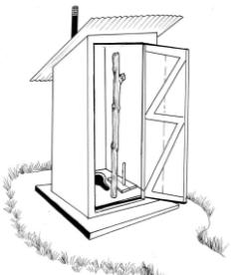
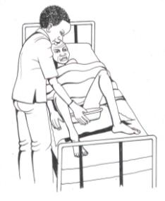
Sanitation Actions
Support latrine construction or enhancements so all family members use latrine and/or potty
Construct larger latrine and install support poles or stools to assist PLHIV
Include handwashing materials in basic care package including how to make tippy taps
Support WASH-HIV integration capacity strengthening

Slide 10
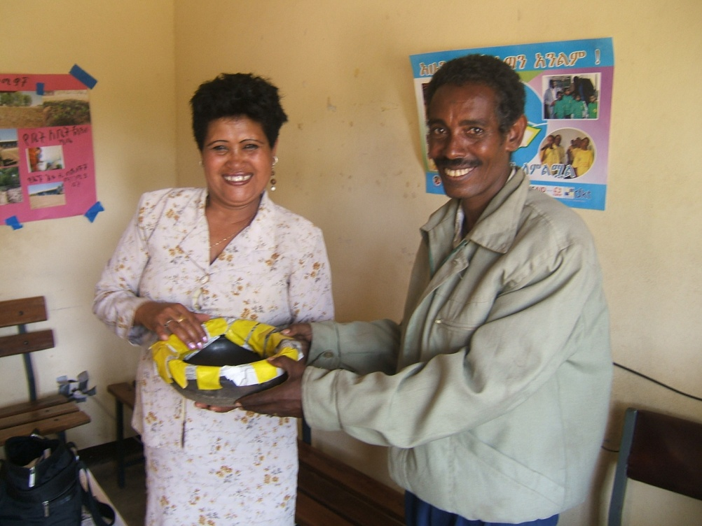
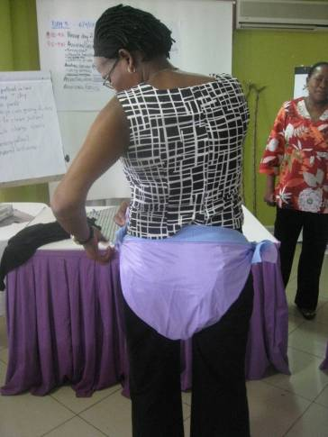
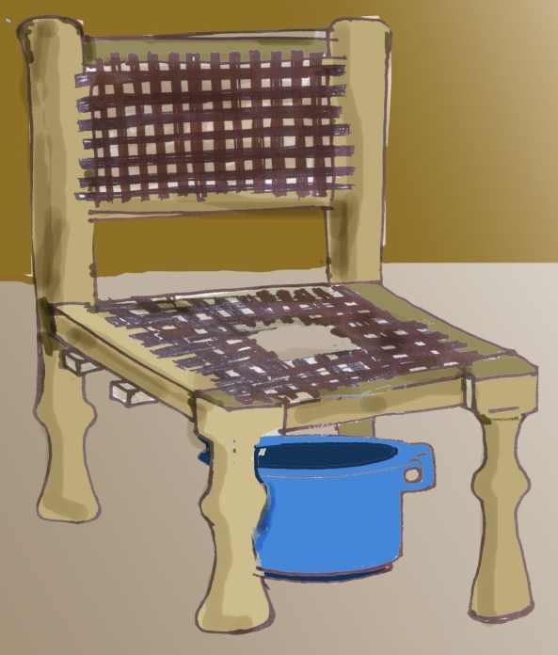
Plastic Pants
“Home-made” Bedpans
Bedside
Commode
Notes:
A bedbound client needs specialized assistance. Support Caregivers to understand how to develop the supplies to assist the bedbound client….these might be plastic pants, a bedside commode or bedpans - and for the truly bedbound, plastic sheeting to protect the bedding. Caregivers need to be taught how to change the soiled linens from under someone who cannot get out of bed or even sit up and they need to be taught how to adequately clean the client.
Another important feature was placing hand washing supplies, cloths and cleansers close enough to the patients so they can take care of themselves if they are able to.

Slide 11
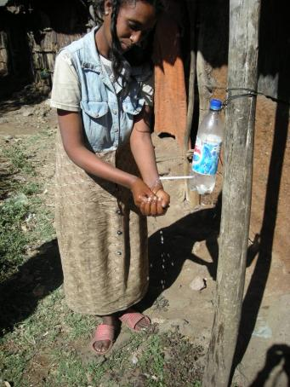
Hand Washing
Sanitation must be accompanied by handwashing
Use tippy tap to conserve water
Create hand washing station next to client and next to latrine
When soap is not available, use ash for hand washing—rub hands together, rinse, and air drying.
Using a tippy tap
Notes:
Handwashing is an essential aspect of sanitation and hygiene…
Research has shown that placement of a fixed handwashing station, in close proximity to the latrine, bedside, kitchen reduces barriers to handwashing and increases the hygiene practice. Having it ‘in your face’ also serves as a much-needed reminder.
Constructing and mounting a water saving device called a tippy tap, pictured here, further facilitates handwashing. A tippy tap functions like a tap and allows water to run on the hand to remove the dirt when running water isn’t available, and allows for a correct handwash with about ¼ of the water.
Promotional and instructional materials can be included within the basic care package, as well as incorporated into all outreach worker trainings.
The key message: Place the tippy tap and the soap or soap replacement next to the latrine and or next the to bed bound client.
When soap is not available use soap replacement such as ash, and wash hands properly; this means: wet hands, lather with soap, rub hands together, rinse and air dry.

Slide 12
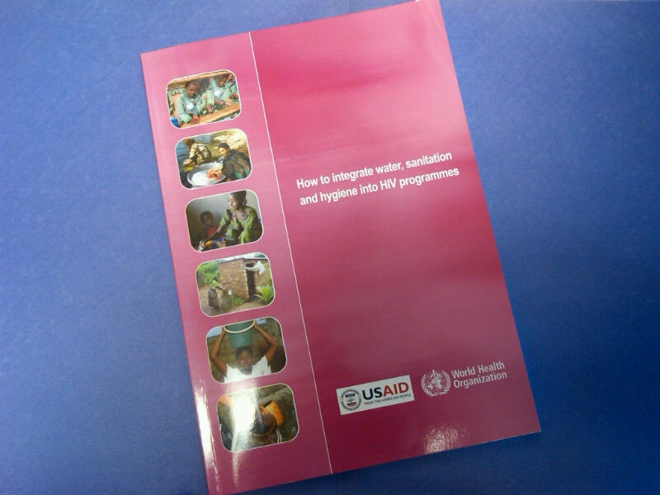
Guidance for Integration of WASH
to influence practice and flow of funds
WHO/USAID JOINT PUBLICATION
How to integrate WASH
into HIV programs
Notes:
Extensive guidance for integrating WASH, as well as sample job aids, can be found in the WHO/USAID JOINT PUBLICATION How to integrate WASH into HIV programs

Slide 13
YOU and PEPFAR CAN MAKE A DIFFERENCE!
Incorporate sanitation systematically into all areas of HIV
Incorporate HIV considerations into water and sanitation programs
Address urban sanitation -- a huge problem that is exacerbated in the HIV context
Finance sanitation activities in HIV programming
Notes:
PEPFAR is changing to emphasize integration to maintain health as the epidemic moves from a crisis to a long-term care issue. Sanitation is a critical component that is often forgotten in the realm of water, sanitation and hygiene. But it is critically important to prevent feces from contaminating the environment and compromising human health. When everyone in a community has access to and uses a latrine, diarrheal disease decreases and this is particularly important for people living with HIV.
The water and sanitation sectors are sometimes aware of the need to incorporate HIV considerations into their specific water and sanitation programming, but they are not always clear on how to do this. New programs should work more closely with the water and sanitation sectors to determine the gaps and develop strategies to fill them.
Urban sanitation is always a challenge. Many solutions depend on communal financing to use a latrine. This puts an extra economic burden on households that are affected by HIV. Further, stigma considerations are can cause problems and limit latrine access. More research and programming options need to be explored in this context.
PEPFAR funding can be used to support sanitation efforts in countries. The key is to build these activities into your portfolio. They are simple, inexpensive and effective.

