Slide 1
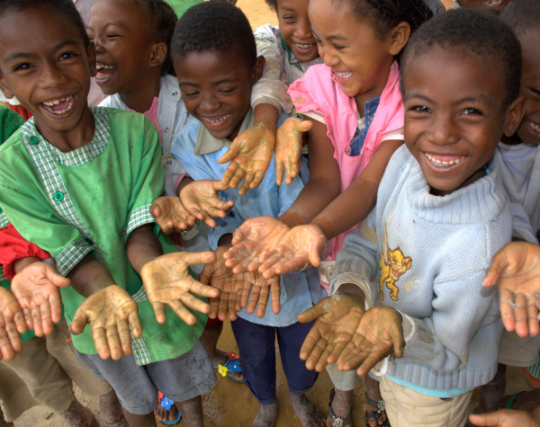
Why WASH-NTDs Matter
WASHplus Project
April 2016

Slide 2
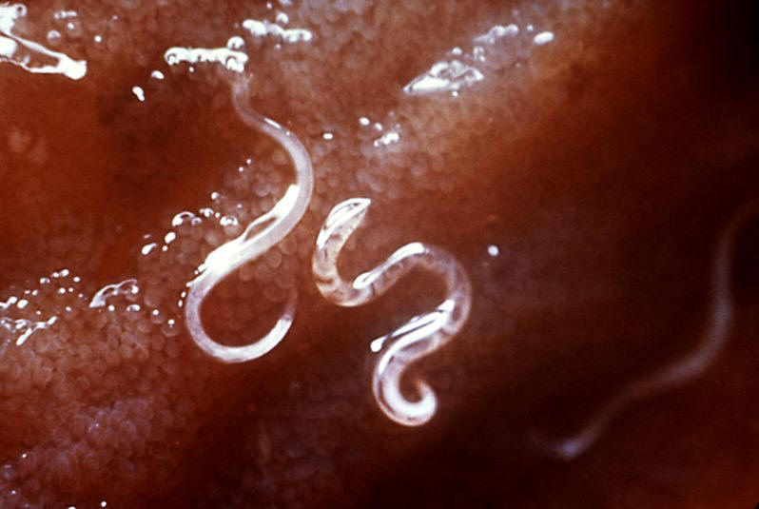
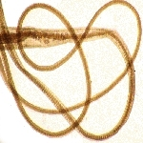
What are NTDs?
Soil transmitted helminths (Worms)
Round worm
Whip worm
Hook worm
Schistosomiasis
Trachoma
Lymphatic filariasis (elephantiasis)
Onchocerciasis (river blindness)
Notes:
These diseases are grouped together and called neglected tropical diseases because they have not been the focus of many health programs and this grouping brought renewed attention to them.
The World Health Organization classifies 17 diseases as NTDs but USAIDs NTD program focuses on the 7 of the most prevalent NTDs can be controlled using preventive chemotherapy that has been proven safe and effective and that can be delivered in an integrated manner through mass drug administration. (Renu – this might be better on the next slide or maybe just phrased differently)
More than 1 billion people suffer from one or more of these painful debilitating diseases that disproportionately affect poor and rural populations around the world.
Cause severe sickness and disability
Compromise mental and physical development
Contribute to childhood malnutrition
Reduce school enrollment
Hinder economic productivity.

Slide 3
How to address NTDs?
Preventive chemotherapy
Innovative and intensified disease management
Vector control and pesticide management
Safe drinking water, basic sanitation and hygiene services and education
Veterinary public health services
Notes:
The USAID NTD program currently has programs to eliminate or control NTDs in 31 countries (6 of these in Latin America through a regional program). The primary activity is helping governments design and implement national mass drug administration programs in those areas endemic for disease. Several drug companies are donating the drugs to help eliminate or control the various diseases and USAID is assisting the countries to implement these Mass drug administration programs also called MDA and monitor the disease levels in the country. This program represents one of the largest public private partnerships at USAID.
The link between water, sanitation and hygiene (WASH) and NTDs were described 100 years ago when the Rockefeller Sanitation Commission defined the challenges associated with hookwork elimination in the United States.
Improved WASH practices can influence three different NTDs of interest to USAID:
Soil transmitted helminths
Trachoma
Schistosomiasis

Slide 4
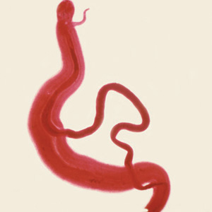
Elimination or Control
Trachoma is targeted for elimination by 2020
Schistosomiasis and STH are targeted for control
Notes:
Elimination is the interruption of transmission of the disease and reducing to zero the incidence of infection caused by a specific pathogen in a defined geographical area as the result of deliberate efforts. Continued action to prevent re-establishment of transmission may be required.
Control is reducing the disease incidence, prevalence, intensity, morbidity or mortality or a combination of these as a result of deliberate efforts. Using the term “elimiation as a public health problem” can only be used when certain internationally recognized targets have been met.

Slide 5
Notes:
This slide describes the 5 WASH-related NTDs, how they are transmitted and how many people are infected and at risk of becoming infected.

Slide 6
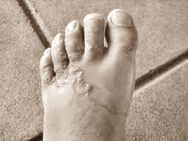
STH - Worms
MDA is first line of defense
To prevent reinfection
Effective Sanitation
Sewage disposal and treatment
Shoes (to prevent for hook worm)
Notes:
Soil-transmitted Helminthes: Repeated infection can lead to malnutrition, iron deficiency anaemia, growth retardation and impaired cognitive development
STH morbidity can be controlled through regularly administering preventive chemotherapy with antihelminthic medicines (albendazole or mebendazole). WHO estimates that about 890 million children require annual treatment with preventive chemotherapy.
Although mass drug administration has been possible to date, drugs alone cannot sustainably control the STH burden in 75–100 percent of children by 2020.
Children must have access to effective sanitation, sewage disposal and treatment to reduce risk of reinfection and decrease need for continued treatment.

Slide 7
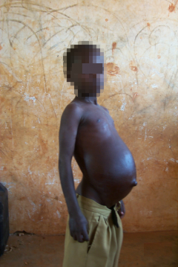
Schistosomiasis
Mass drug administration
To break the cycle/prevent
reinfection
Improved sanitation
Save drinking water
Snail control
No peeing in rivers/lakes
Notes:
Schistosomiasis:
Schistosomiasis or bilharzia is caused by flatworms (schistosomes)
In children: anemia and stunting, resulting in reduced ability to learn
In adults: chronic diseases
Urinary: bladder and kidney damages
Intestinal: liver, spleen, and intestinal damages
Treatment with praziquantel has been the mainstay of schistosomiasis control since 1984 and has been used for preventive chemotherapy since 2006. The goal of ensuring that at least 75 percent of school-aged children have access to this preventive chemotherapy has yet to be reached. WHO has established targets and milestones for eliminating schistosomiasis toward this goal, i.e., 75 percent national coverage in all countries requiring preventive chemotherapy. WHO states that delivering effective preventive chemotherapy requires hygiene education, improved sanitation, safe drinking water, and snail control.

Slide 8
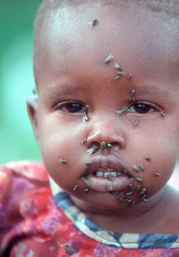
Trachoma
SAFE Strategy
Surgery for people with trachoma troustrichaisis
Antibiotics to reduce chlamydial infection
Facial cleanliness to reduce transmission risk
Environmental improvements
Sanitation, hygiene behaviors, face washing
Notes:
Trachoma:
Caused by Chlamydia trachomatis
Repeated infections
eyelid turn inwards
eyelashes rub and scar the cornea (pain !)
Irreversible blindness
In 1998, WHO formed the Alliance for the Global Elimination of Blinding Trachoma by 2020 (GET2020) and introduced the SAFE strategy. The strategy includes Surgery for individuals with trachoma toustrichaisis; Antibiotics to reduce chlamydial infection; Facial cleanliness to reduce the risk of transmission; and Environmental improvements, including safely managing animal and human excreta, promoting hygienic behaviors to change those that spread disease, and improving access to safe water and sanitation.

Slide 9
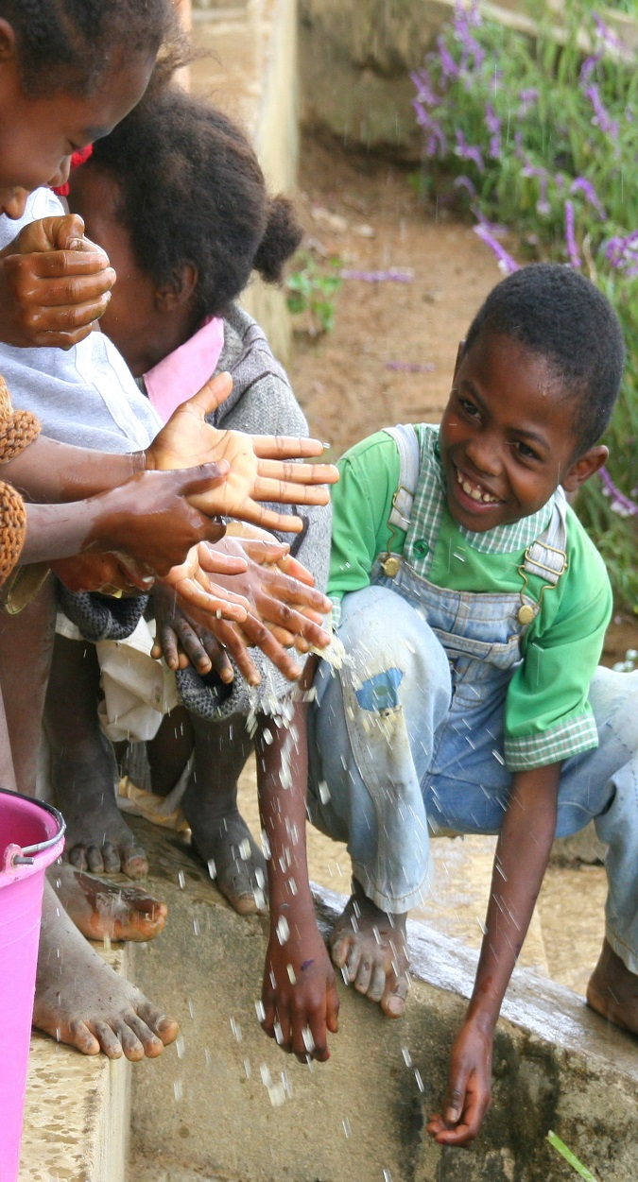
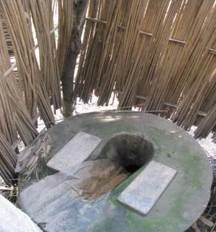
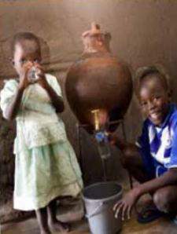
Focus on Behaviors
Proper Sanitation
Handwashing
Face Washing
Safe Storage & Treatment of Water
Wearing shoes
No Peeing in Open Water
No Bathing/Playing in Open Water Sources
Safe Feces Disposal

Slide 10
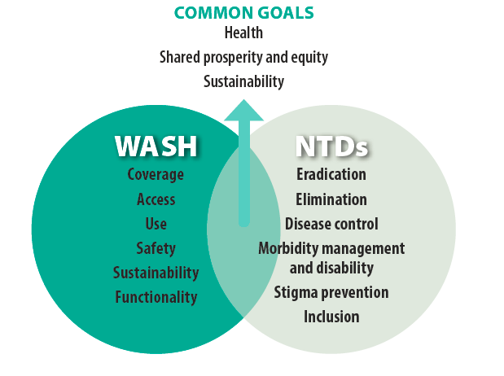
Common ground for collaboration
Source: WHO, 2015
Notes:
This slide shows the overlap and the role for WASH in helping to prevent the spread of these diseases.

