Slide 1
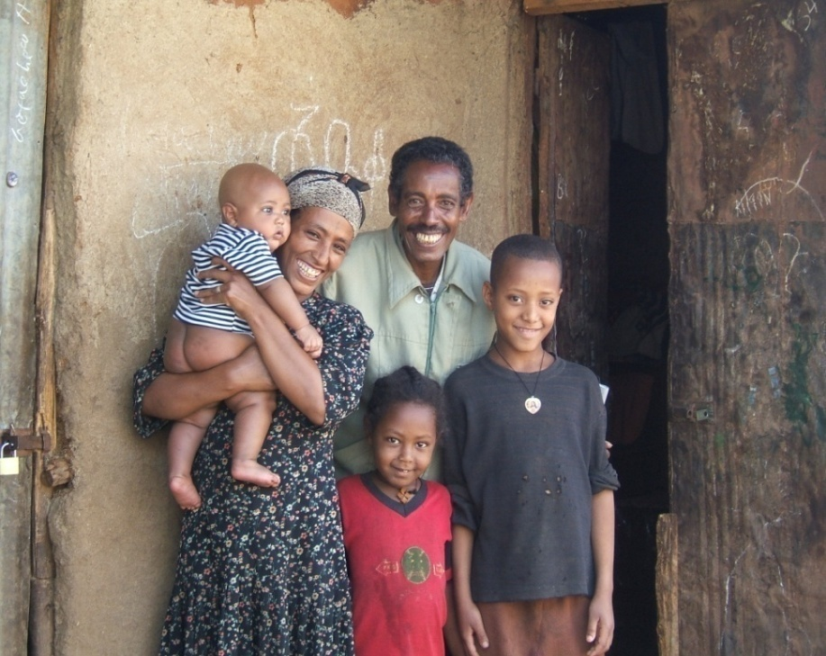
Why WASH-HIV Matters
WASHplus Project
April 2016

Slide 2
Why WASH Matters for PLHIV
Diarrhea…
Affects 90% of people living with HIV and AIDS, causing significant morbidity and mortality
Reduces antiretroviral absorption
Reduces absorption of nutrients
Increases burden on caregivers in clinics and at home
Causes humiliation and lower quality of life
People with HIV/AIDS have greater water needs
Notes:
As we know, most diarrhea is caused by unsafe water, inadequate sanitation and poor hygiene….
in people with immune compromised systems, diarrhea can happen more often and more severely
Most people living with HIV get diarrhea….
And diarrhea reduces a body’s ability to absorb life saving medicines and nutrients in food….this causes malnutrition which further exacerbates the effects of HIV
Further….care givers have increased work in taking care of someone with diarrhea and the feces in the environment puts others in the home at risk of getting diarrhea as well

Slide 3
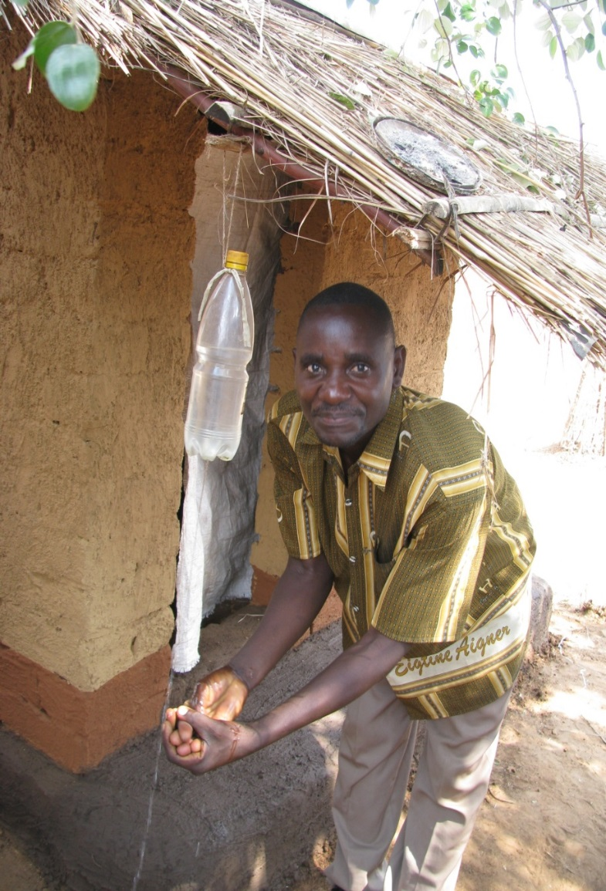
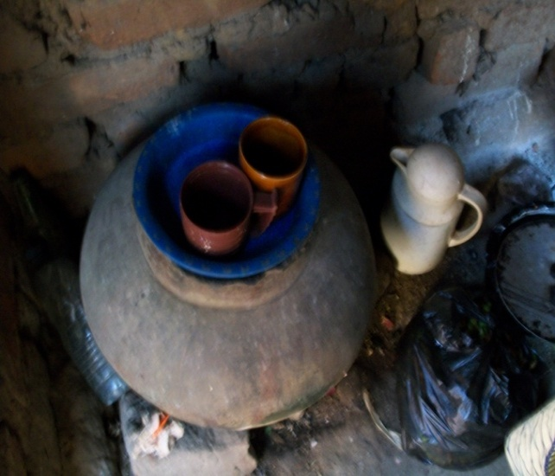
Key WASH Practices
Notes:
Three practices: Treating and Safely Storing Drinking Water, Using a Latrine, and Washing Hands with Soap have been shown to reduce incidence of diarrhea.
In general, hand washing has been shown to reduce the risk of diarrhea by over 40 percent.
One key study in Uganda conducted by Lule reported that the presence of soap in an HIV affected household was associated with a reduced number of days with diarrhea.

Slide 4
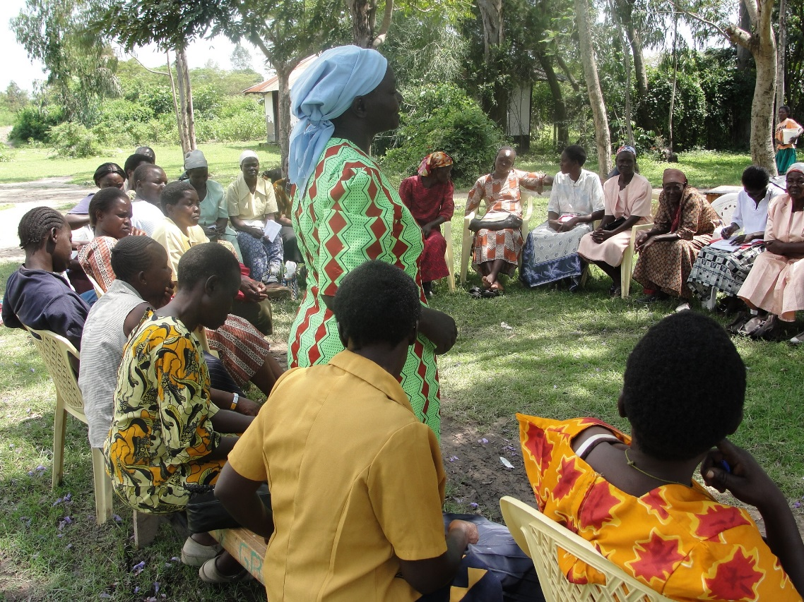
Integrating WASH into HIV programs
Home-based Care
Nutrition and HIV
Orphans and Vulnerable Children
Prevention of Mother to Child Transmission
Counseling and Testing
Notes:
WASH makes a difference…so the question was HOW can you improve these WASH practices
Diarrhea affects more than just the person who is sick…it can affect everyone,
and everyone needs to improve hygiene behaviors to prevent diarrhea…so in fact, WASH can help to destigmatize HIV….since it is vital for everyone
In the past WASHplus has focused on integrating WASH into home-based care programs through existing mechanisms such as home based care workers or community health workers.
But many opportunities exist in other areas…We are promoting WASH in nutrition and HIV, OVC and PMTCT programs to counsel clients on improved WASH behaviors such as hand washing, and using a latrine.
HIP realized that not much was being done to try to reduce diarrhea in the context of HIV.

Slide 5
Local Solutions – Small Doable Actions
BIG CHANGES ARE NEEDED!
Everyone has the right to safe water, a place for hygiene and sanitation
Things can be done today (or tomorrow), with existing skills and resources, in the most resource constrained settings
Notes:
Builds on assets-based community development and health behavior change theory
Small doable actions are incremental steps that move toward the ideal…..for example, you can’t go from bringing water from the river to piped water system in your home in one step….the key is thinking about what is possible and feasible for you to do in your home…..

Slide 6
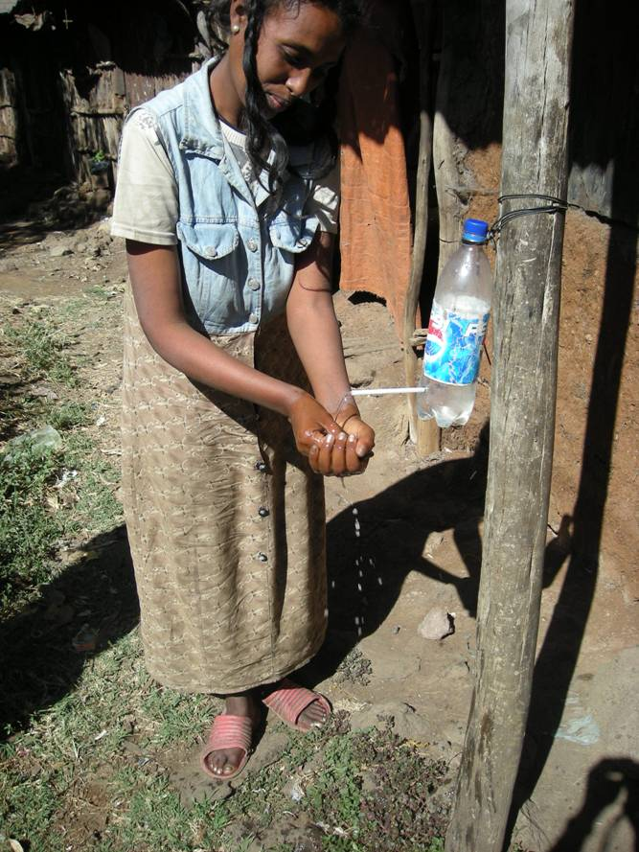
Small Doable Action Approach
Identify feasible steps that move people from a current WASH practice toward the ideal practice
Identify existing hygiene and sanitation good practices to be reinforced and congratulate the HIV-positive householder/caregiver for these practices
Identify practices to be improved and negotiate the options with HIV-positive person/caregiver
Notes:
The precursor to the WASHplus project developed what we call the small doable action approach to help people move toward ideal practices in safe drinking water,
Hand washing and sanitation. We know that people need an environment and technologies that makes this possible…
So for example, people need access to water to wash their hands and they need a dedicated place to do it. But often
Getting access to everything needed is impossible, so we need to identify small steps that will move people toward the ideal practice…slowly….
Then outreach or homebased care workers need to identify people’s current practices and congratulate them on the those that are good and health
This helps to motivate people to continue to do these practices.
Then these outreach workers need to identify practices that can be improved and negotiate options with the person living with HIV or
Another household member to try a small actions to improve the practice and so that it is healthier for the person and family members

Slide 7
Hand Washing Practices
Current Practices Needing Improvement
Hand washing without soap when soap is not available
“Dip” hand washing from communal bowl
No systematic hand washing after cleaning the potty or after defecation
No systematic hand washing before eating/cooking, before/after caring for sick or before providing medicine to client
“Dip” hand washing
Notes:
Hand washing
Current practice needing improvement
Wash hand with water and soap if soap is available and if not with water only
Dip hands washing from a bowl used by all family members
No “systematic” hand washing at critical times

Slide 8
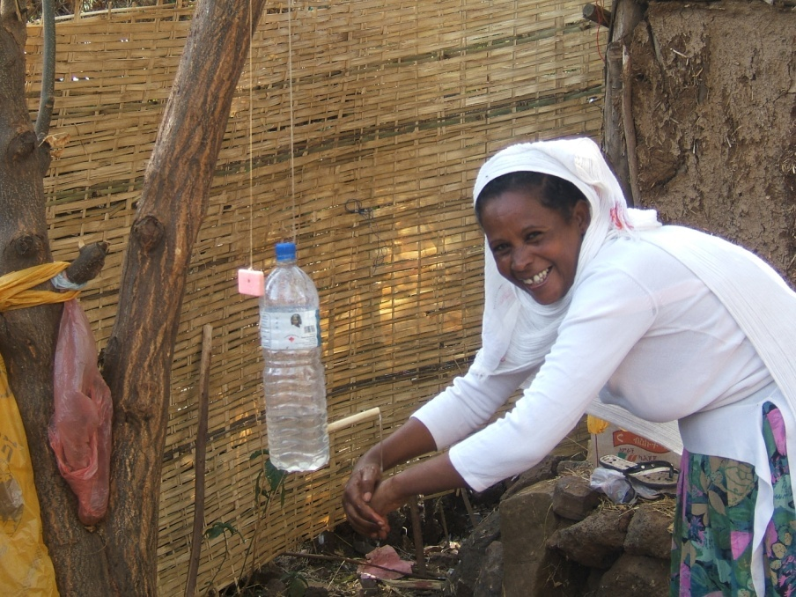
Hand Washing — Small Doable Actions
Small Doable Actions
Use tippy tap to conserve water
Create hand washing station next to client and next to latrine
When soap is not available, use ash for hand washing—rub hands together, rinse, and air drying.
Notes:
Hand washing SDA
Use a water saving device, tippy tap. A tippy tap functions like a tap and allow water to run on the hand to remove the dirt
Place the tippy tap and the soap or soap replacement next to the latrine and or next the to bed bound client
When soap is not available use soap replacement such as ash, and wash hands properly; this means: wet hands, lather with soap, rub hands together, rinse and air dry.

Slide 9
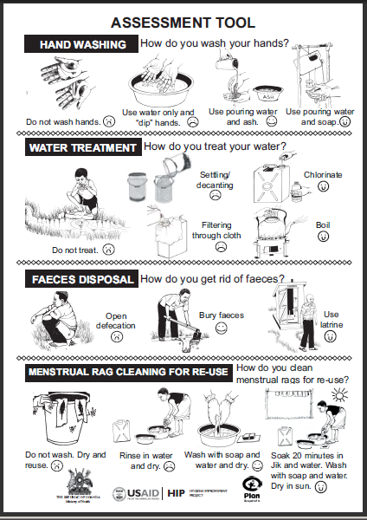
Tools
Negotiate small doable actions using pictorially based assessment and counseling tools
Notes:
This Assessment Tool from Uganda is used to assess a HH current wash practices in each of the 4 WASH behaviors. The tool is organized so that the behavior on the left side of each row represents the highest risk behavior and as you move towards the right of the row the behaviors represented are less risky with the “ideal” behavior on the far right. This continuum of behaviors can be used as a “decision tree” to help the outreach worker understand where the HH priority needs are and can be used to initiate negotiation of improved behaviors. Similar assessment tools have been developed in each of the countries where WASHplus works.

Slide 10
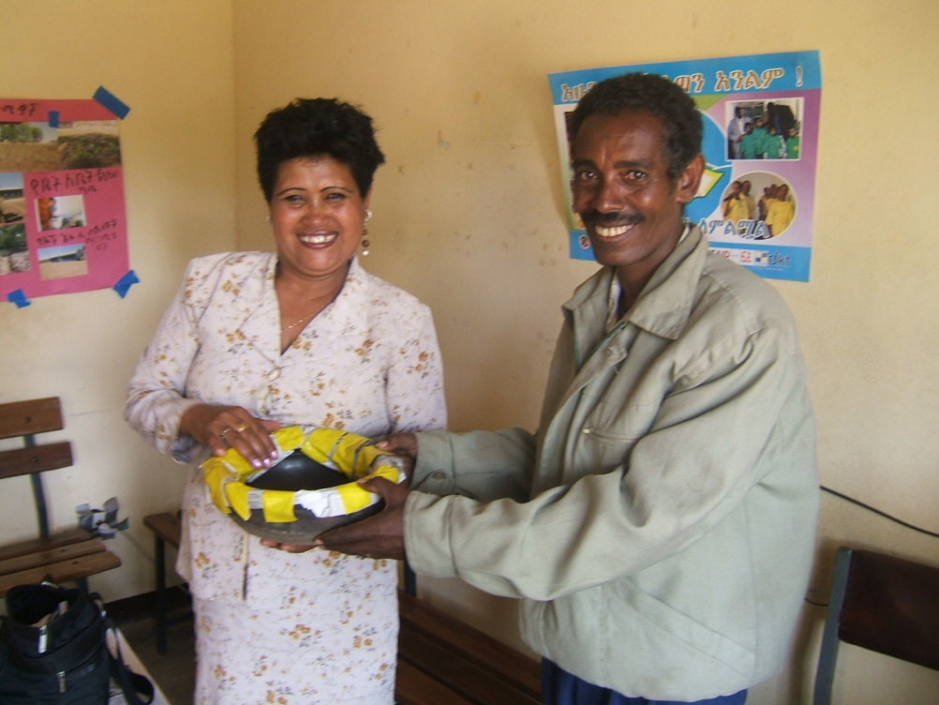
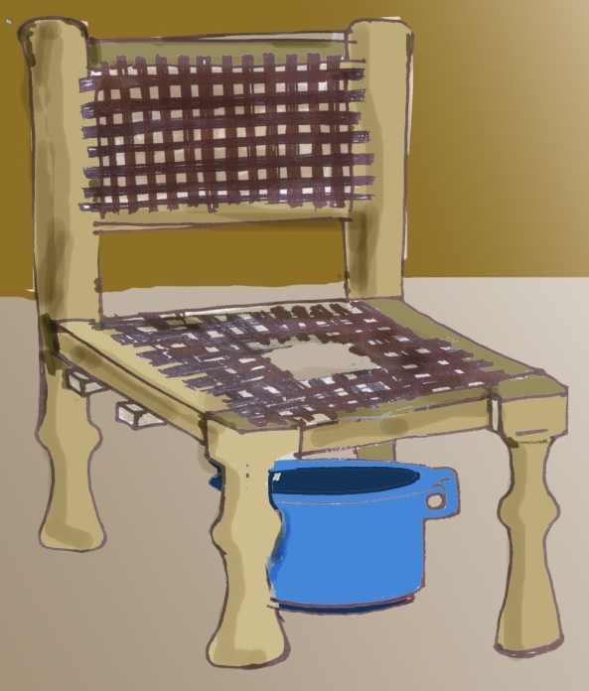
Other Local Solutions…
Bedpan
Plastic Pants
Bedside
Commode
Notes:
Here are some innovative small doable actions that people in different countries have developed to help people living with HIV address diarrhea.
In Uganda, they found a way to make some plastic pants with plastic bags.
In Ethiopia, one organization covered a clay pot with newspapers to make a bed pan
In Kenya and in other countries they cut holes in a chair to make a commode for weak and elderly people who cannot use a latrine….these are solutions that grow organically and depend on what is available in the environment and creative thinking…
In all these countries, community health and home-based care workers are helping families develop simple supportive technologies such as poles or ropes or straps, cleaning the path to the latrine and building handwashing stations outside latrines to allow those affected by HIV to use a latrine comfortably and without help.
These simple local solutions can mean big differences to a person’s dignity and ability to function

