Slide 1
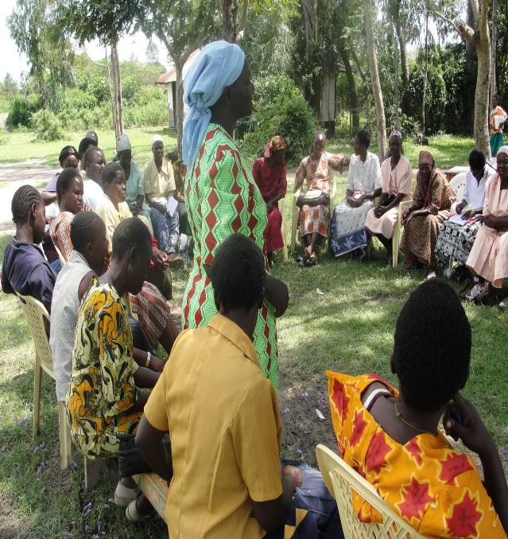

WASH, HIV and Inclusive Sanitation in Kenya
WASHplus Project
April 2016
Notes:
WASHPlus is a national mechanism
Supporting the MOPHS and NGO partners including A+ partners, CDC implementing partners

Slide 2
Small Doable Action Approach
WASHplus introduced and promoted the small doable action (SDAs) concept, now accepted by government WASH actors
Results
  SDAs have improved WASH practices by helping households identify feasible incremental steps that move them from a current hygiene practice toward the ideal practice
  CHWs use the SDA approach to negotiate improved WASH practices with household

Slide 3
Capacity Building
Innovative Training & Materials
Developed a training curriculum for WASH-HIV integration ( training guide and job aids for CHWs (now CHVs)
Used a participatory training style – teach back methodology – focus is on training skills
Results
  Trained over 650 trainers (MOH & NGO) on WASH-HIV integration
  Over 8 000 CHWs trained on WASH-HIV integration and inclusive sanitation through Community Strategy

Slide 4
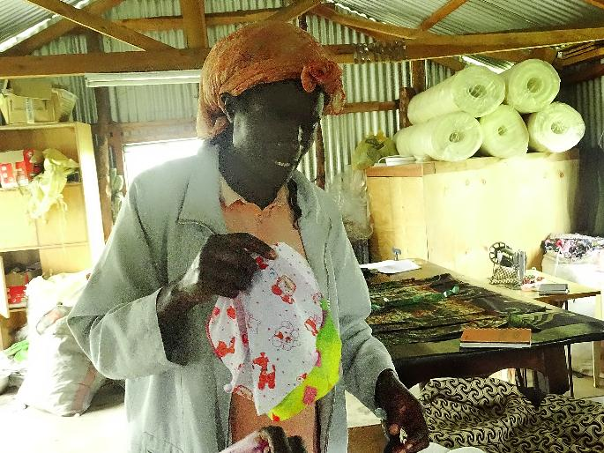
Menstrual Hygiene Management
Improving access to sanitary pads for girls and women is feasible for communities
Results
  Mainstreamed MHM in WASH interventions through SDAs
  Trained CHWs in collaboration with school administrators and teachers on MHM
  Including a session on MHM in the training guide and the job aid
  Through HPTWG- held the 1st MH day

Slide 5
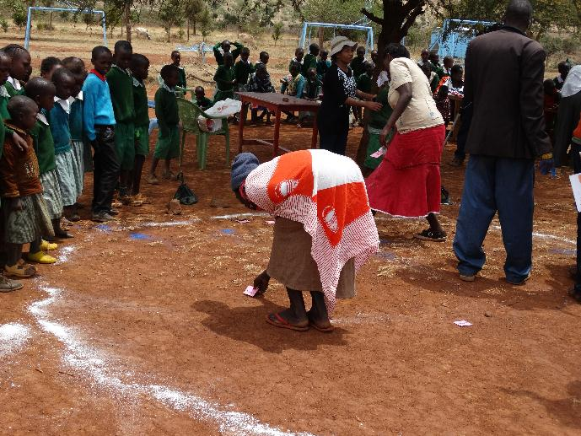
Increase Sanitation Uptake through CLTSplus
Sanitation pilot program worked closely with the MOH
Key results
  Over 500 CLTS implementers (PHOs, CHVs & natural leaders) trained/ sensentized
  CHWs & natural leaders negotiate and demonstrate how to make supportive devices for individuals with disabilities
  1 sub-location declared ODF, 47 villages claiming ODF
  Trained 3rd party certifiers (23 in Nakuru county)

Slide 6
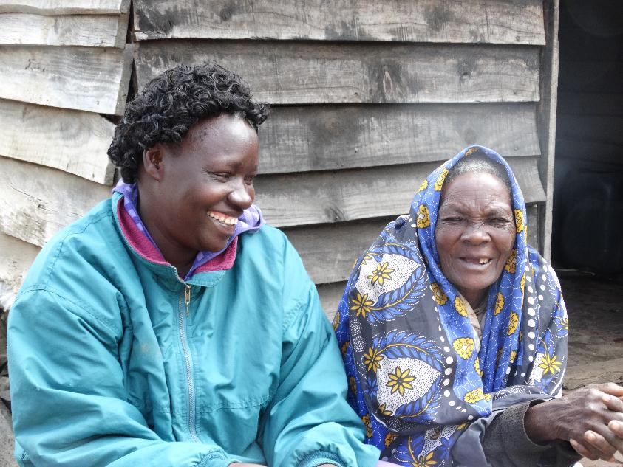
Inclusive Sanitation
WASHplus = first program to introduce inclusive sanitation
Key results
  Over 100 PHOs trained on equity and inclusion
  About 50 people living with disabilities have supportive devices such as commodes, support bars, and guiding ropes
  Provided TA in development of the KI- SHIP proposal –submitted to GSF
Notes:
Kenya is a signatory to global commitments on universal access to WASH services
Sanitation for All (SWA)- HLM Country commitments-
HLM in Washington DC in April this year issues that came up
child mortality -caused by diarrhea- 1400 children per day
Billions of dollars/KES lost of Economic growth
Equity & inclusion-hundreds of millions of women and girls, disabled persons, pastoralists and other poor and marginalized communities are disproportionally affected without services.
Equity and inclusion is an indicator- Global tool- GLASS
Sanitation is a constitutional right in Kenya
National ESH Policy and strategy- review on going to align with the constitution
County commitments – Recent National Sanitation conference
“accelerating access to improved sanitation under devolution: making the right a reality

Slide 7
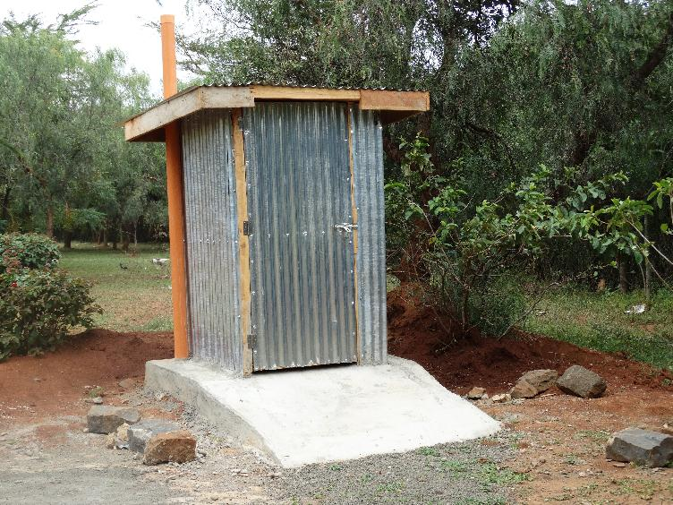
Improved Sanitation from the Outset
Uptake of improved sanitation created through increased awareness of CLTS+
Key results
13 artisans trained on:
Approximately 26 improved latrines have been constructed in just one location of Naivasha subcounty.
Developed a Checklist for follow up
Notes:
digging circular pits, laying bricks to stabilize the base and floor, smooth cast for easy cleaning.

Slide 8
Partnerships and Collaborations
  WASHplus -national” program with little capacity to implement activities at the community level,
Key results
  Successfully developed strong relationships with the MOH and partners
  Convened the national Hygiene and Promotion Technical Working Group under which
  Together with WSP, MOH and developed a simple pit options guide for CHWs and NL

Slide 9
Finance and cost-share
  Strong relationship partners made it possible to cost-share in key initiatives
  Results
  Cost share possible with MOH-at the counties- mobilized funds from other sources and WASHplus provided TA only
  WSP, Pskenya,WVI, MWA, Millennium Water Alliance, AMREF, Plan International Living Water and KWAHO

Slide 10
Sustainability
  Worked with and strengthened existing government structures and personnel
  Supported Counties to develop work plans and budget allocations for sanitation
  Provided TA to develop national guidelines, training manuals and job aids
Results
  Relevant MOH relevant staff capacity strengthened

Slide 11
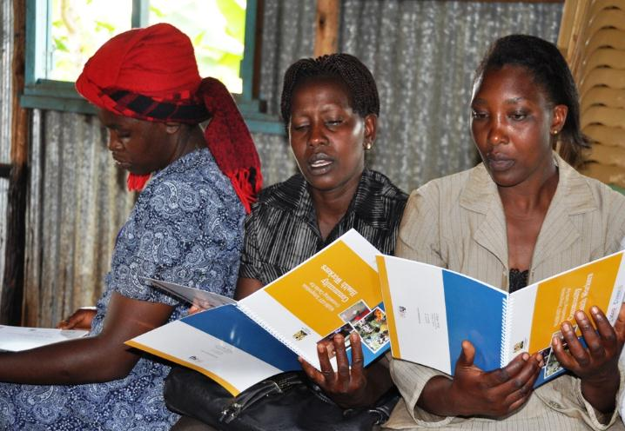
Documents developed
WASH-HIV integration training guide
WASH-HIV integration counseling cards/ job aids
Simple Latrine pit options job aid
Inclusive sanitation materials
Inclusive Sanitation Checklist- draft
GOK/MOH Community Health Worker Training Chapter 7 on WASH
MOH check list for trained local artisans

Slide 12
Presentations/Posters
Promoting Healthy Hygiene and Sanitation Practices for People Living with HIV and AIDS. 36th WEDC international Conference, Nakuru, Kenya-2013.
Integration Inspires Sustained Behaviour Change and Innovation in Kenya. UNC 2013 Water and Health Conference, Chapel Hill, NC
Mainstreaming Inclusive Sanitation into Community-Led Total Sanitation in Kenya. 37th WEDC international Conference, Hanoi, Vietnam-2014

Slide 13
Lessons Learned
Flexibility Can Foster Creative Programming
  WASHplus operated without a clear picture of future funding at the outset. Yet, the project took shape and seized opportunities to make a difference
Small Doable Actions resonate
  Many different WASH efforts focus on feasible actions to improve health rather than unattainable ideals.
Notes:
How?
WASHplus chose to work within existing structures (Government of Kenya’s community strategy). This ensured that new concepts were accepted because they were jointly developed and shared. Further, the corresponding materials were resonant, relevant, and sustained within and across programs.
The structured rollout of the WASHplus approach from province to district, initially introduced in a few provinces and then expanded to all provinces and later to county stakeholders, allowed time to test the approach, make adjustments, and present results. Through promotion, counties wanted to be trained and wanted to be involved.
Periodic meetings among the senior government stakeholders generated attention and ideas and spurred creativity in expanding the activities using the small doable action approach to identify actions and opportunities to advance the program with limited funding and creative financing within the government’s own system.
Incremental funding meant the project was not locked into a rigid five-year work scope. Indeed, the flexibility allowed WASHplus to shift focus and resources to areas that needed attention but had not been adequately considered or planned in advance. For example, when WASHplus learned that communities with early child development centers still practiced open defecation, the project identified and addressed the cause—ECD teachers were unaware that their sanitation facilities could not accommodate all the students during the breaks. WASHplus recognized this and shifted resources to focus on this new target audience.

Slide 14
Lessons Learned cont..
Partnerships Enhance Outputs
  System strengthening for Sustainability
Inclusive Sanitation Efforts Move from Policy to Practice
  Link between policy and implementation is not always straight forward- implementers must identify practical ways to operationalise the concept

Slide 15
What are we leaving behind..
WASH-HIV integration training guide (both English and Kiswahili)
WASH-HIV integration CHWs job aids- (both English and Kiswahili)
National CLTS protocol
Facilitators guide: Community Health Volunteers WASH- module 7
WASH Factsheets & book marks
Stories from the Field (9)
Simple Latrine pit options job aid
Inclusive Sanitation Checklist- draft
MOH check list for trained local artisans

Slide 16
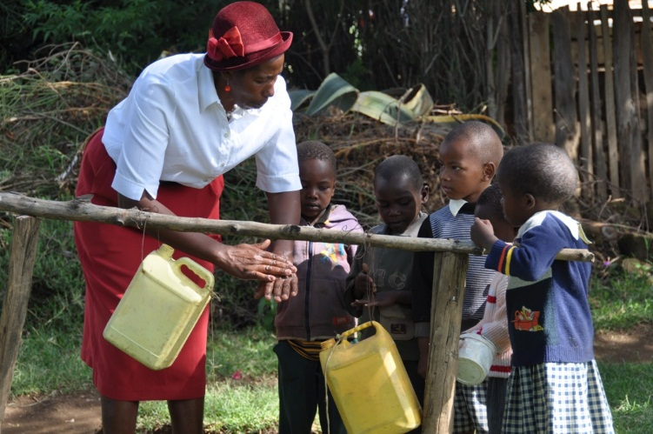
Thank you

