Slide 1
Mainstreaming inclusive sanitation into community-led total sanitation in Kenya
E. Mugambi,— WASHplus Project, FHI 360
September, 2014
Notes:
WASHPlus is USAID’s mechanism for supporting global and country-level environmental health programming
Goal is to support improvement of Safe and sufficient water, hygiene, and sanitation practice in homes and institutions. The “plus” is household air pollution.
WASHPlus in Kenya is Managed by FHI 360
Supports the MOH and NGO partners To improve WASH practices of communities, families, and individuals with special focus on vulnerable communities

Slide 2
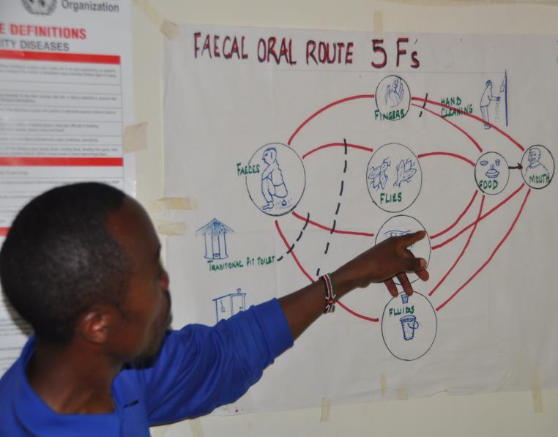
Background
Approx. 19,500 Kenyans, including 17,100 children under 5, die from diarrhoea yearly
Nearly 90% is directly attributed to poor WASH practices (GoK, 2012).
About 14% practice open defecation
17% live in rural areas (JMP 2013)
Notes:
About 80% of Kenyans in hospital suffer from hygiene and sanitation related illnesses
Most communities that practice open defecation are not able to relate sanitation illness with poor WASH practices
Lack of access to improved sanitation is also a significant public health burden that costs the country nearly one percent of its GDP every year

Slide 3
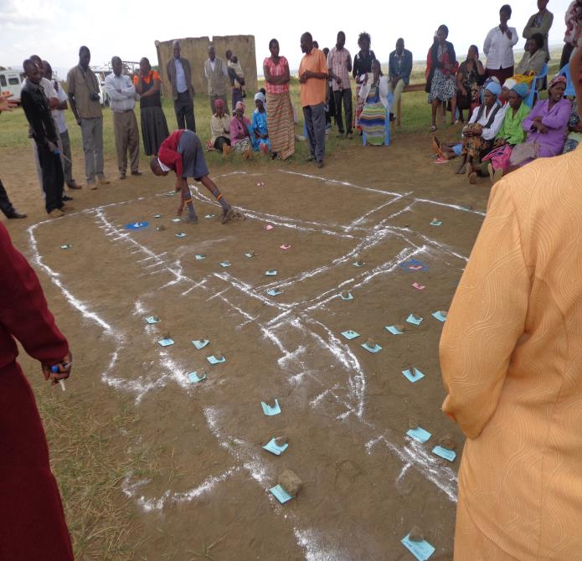
CLTS Approach in Kenya
MOH Kenya adopted CLTS in 2008
Aims to accelerate uptake of basic sanitation in rural Kenya
But there was a gap…
If CLTS aims at total sanitation, then it has to be inclusive (Wilbur, J. and Jones, H. 2014)
Notes:
Community-led total sanitation (CLTS) is an innovative methodology for mobilizing communities to completely eliminate open defecation. Communities are facilitated to conduct their own appraisal and analysis of open defecation and take their own action to become open defecation free (ODF) (Kar and Chambers, 2008).
The MOH in Kenya adopted CLTS in 2008.
At the start of the WASHplus program-carried out a gap analysis/learning lessons from CLTS implementers in the sector
The program discovered that though the CLTS approach advocated for construction and use of latrines, the approach in Kenya did not seek to address sanitation needs for individuals with special needs which include people with disabilities
There was need for inclusiveness in CLTS for communities to achieve total sanitation

Slide 4
Why Make CLTS Fully Inclusive?
The 2.5 billion in the world who lack access to adequate sanitation (WHO/UNICEF 2014) include many people with disabilities
Disabled people who cannot access sanitation facilities will either continue with open defecation or will need support
Challenges include access to and use of sanitation facilities with standard designs
Notes:
Globally, approximately 785 million (15.6%) people 15 years and older live with a disability (According to the World Health Survey report)
People living with disabilities face various challenges in the course of pursuing their daily activities because of activity limitation or restrictions. This includes limitations in access and use of sanitation and hygiene facilities made with standard designs.

Slide 5
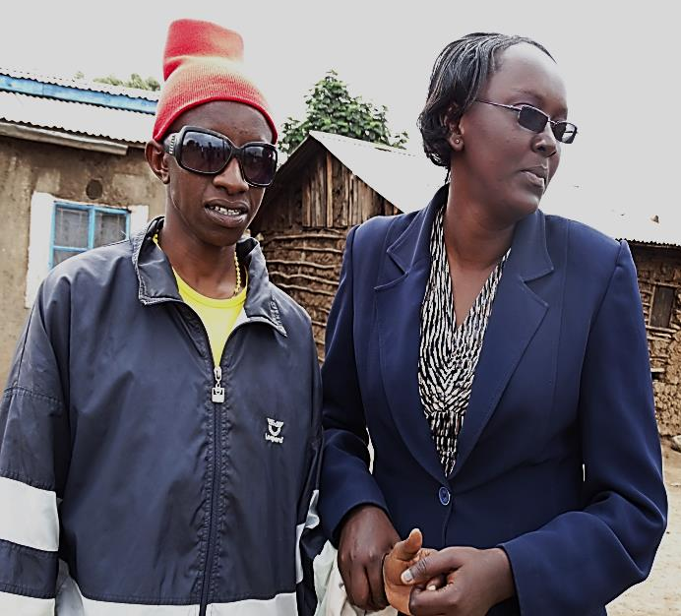
Disability Situation in Kenya
Disability rate in Kenya is estimated at 4.6% (GoK,2008)
Physical impairment - 1.6%
Visual impairment - 1.4%
Despite increased sanitation uptake, people with impaired mobility will continue to be marginalized
Unless sanitation facilities are accessible to all, communities will never be truly ODF
Notes:
Kenya is a signatory to various global commitments on universal access to WASH services requirements.
Global Analysis and Assessment of Sanitation and Drinking-Water Monitoring tool—requires the country to report on policy or plans for universal access of WASH services for disadvantaged groups, including individuals who have physical as well as visual disabilities.
WASHplus is the first program to introduce inclusive sanitation at the community level.

Slide 6
Inclusive Sanitation – Rights Issue
Sanitation is now a constitutional right in Kenya
Article 43 (b)
“Right to accessible and adequate housing, and to reasonable standards of sanitation”
Article 54 (e)
“Right to access materials and devices to overcome constraints arising from the person’s disability.”
We must recognize that people are different and require specific support to overcome impediments blocking their ability to access and use sanitation facilities
Notes:
Human rights and basic freedoms to which humans are considered to be entitled to includes right to life, liberty, equality, fair trial, freedom from slavery and torture and freedom of thought and expression
Although people enjoy all the above rights and freedoms, lack of sanitation obstructs the right to life and health due to diarrhea and other sanitation related diseases.
The Kenyan constitution declares access to “reasonable standards of sanitation” for all Kenyans. The revised National Environmental Sanitation and Hygiene Policy is in the process of aligning the policy with the constitution
Persons with disability also have the “Right to access materials and devices to overcome constraints arising as a result the person’s disability
Equity and inclusion therefore involves recognizing that people are different and require specific support and measures to overcome the impediments that block their ability to access and use services sustainably.

Slide 7
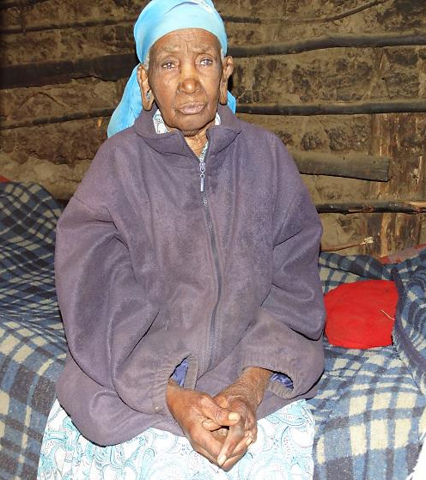
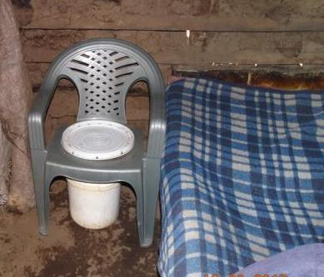
WASHplus Kenya Program – CLTSplus
CLTSplus is implemented through MOH
“plus” component emphasizes hand washing with soap and inclusive sanitation
Focuses on sanitation needs for people with impaired mobility (elderly, physically and visually disabled, and children )
Encourages designing improvised supportive sanitation devices through “Small Doable Action” approach
Notes:
CLTSplus is implemented within the existing MOH CLTS strategy
For WASHPlus the “plus” component included hand washing with soap and inclusive sanitation (sanitation needs for people with impaired mobility (elderly, physically and visually disabled, and children) which lacked in the National CLTS approach in Kenya.
WASHplus promoted small doable actions (SDAs). These are behaviors that are deemed ‘feasible’ and effective to perform in resource constrained settings or households.
These small doable actions are ‘negotiated’ with householders
Rather than focusing on educating households to adopt ideal practices the CHW negotiate with house holds on simple options.
Picture: A commode developed for a weak elderly person in one of the project sites kenya.

Slide 8
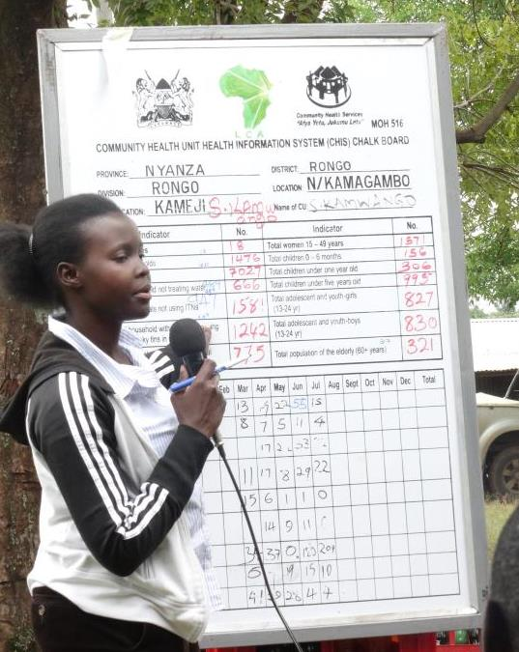
Context - Approach
Build capacity of CLTS implementers on inclusive sanitation—barriers analysis and finding solutions
Implementers include: Public health officers, community health volunteers & natural leaders
Followed CLTS stages, using all triggering tools
MOH’s CLTS M&E tools used to collect data
Modified M&E tools to capture data of households with people with disabilities
Notes:
The program began by training public health officers on CLTS+.
The content of the training included sessions on basic principles of sanitation, introduction to CLTS approach, equity and inclusion for WASH using the social model of exclusion, triggering for behaviour change, monitoring and evaluation
The CLTS+ program encourages implementers to negotiate and support households with physically impaired individuals to embrace the small doable action approach in improvising supportive devices that would facilitate access and use of sanitation facilities at the household level.
In consultation with the MOH at the county level, an indicator to capture data of households with people with disabilities was introduced in the MOH’s CLTS M&E tools

Slide 9
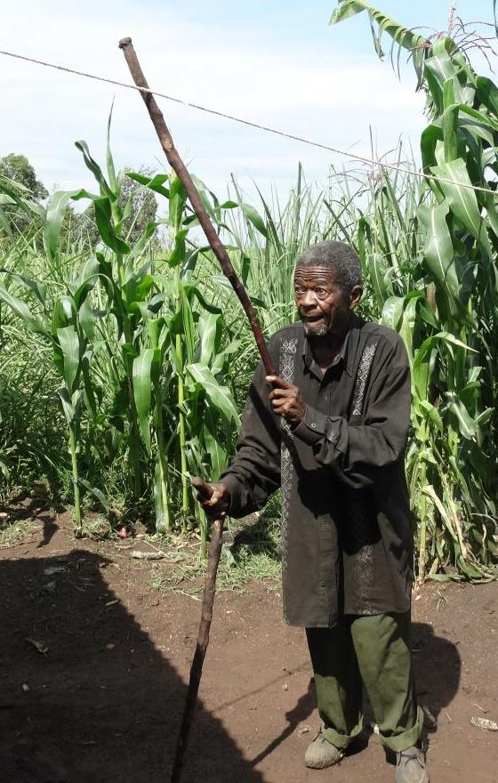
Results
Over 530 CLTS implementers trained on inclusive sanitation
CHWs & natural leaders negotiate and demonstrate how to make supportive devices for individuals with disabilities
WASH knowledge shared with nearly 3,000 community health workers
Notes:
in just 1 ½ years
Over 530 CLTS implementers trained on inclusive sanitation in 3 sub counties/districts.
Implementers negotiate and support households to design improvised supportive devices.
Important to mention is that WASHplus works with the MOH to capture data using the existing MOH/CLTS and community strategy M&E tools- with little modification to capture data on disability at the household level.

Slide 10
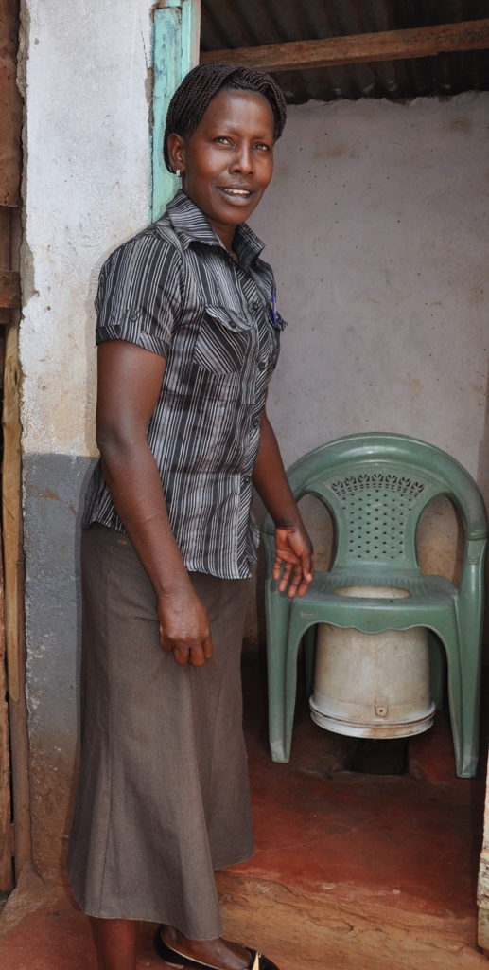
Lessons Learned – Integration in CLTS
Orientation on inclusive sanitation has enlightened CLTS implementers; now being integrated in the national CLTS approach
Indigenous innovation with local materials can change lives of families and individuals
Due to stigma, people affected often do not attend triggering sessions, therefore case-by-case identification of households with persons with disability is important
Notes:
Inclusive sanitation is now being integrated in the national CLTS approach, through national programs such as Kenya Sanitation & Hygiene Integrated (K-SHIP) program a 5 year WSSCC/GSF funded program which is being implemented in 11 counties in Kenya
The revised Country national sanitation documents including sanitation policy, strategy, Open defection free road map are now aligned to the Kenya’s 2010 constitution which recognises sanitation as a constitutional right for all Kenyans. (to be launched on 18th May 2016)

Slide 11
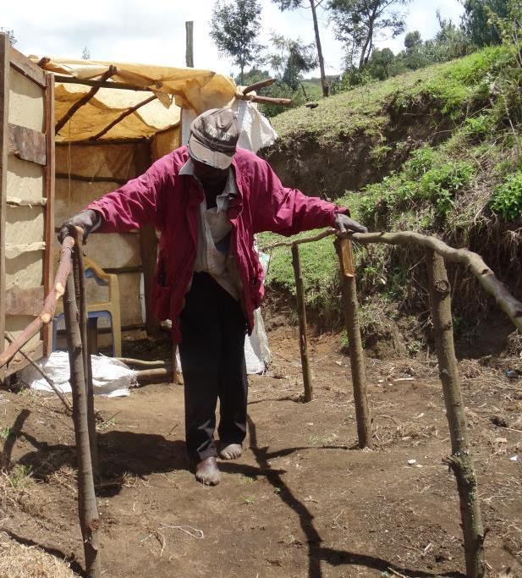
CLTS “Plus” Conclusion
CLTSplus pilot program on the ground had immediate impact
Communities are very innovative in designing solutions when prompted
Policy change required for longer term equity gains and sustainability
Notes:
About 50 people living with disabilities in the WASHplus project area had supportive devices such as commodes, support bars, handrails and guiding ropes at the end of the project.
Caregivers are free to engage in other productive activities while they know that persons under their care can use toilets easily with the help of an improvised supportive device.
Communities designed supportive devices based on the available materials and cultural appropriateness.
The MOH’s efforts to align major sanitation policy documents to the constitution and which has now captured sanitation as a human right is a positive move towards the right direction towards achievement of inclusive sanitation in Kenya.

Slide 12
Thank you
“Facilitate the identification of those who are weaker, poorer, landless or otherwise unable to construct their own toilets. These may be old people, widows, single mothers, the disabled, those who are chronically sick…” (Kar with Chambers 2008).
www.washplus.org

